Slide 1
Miniature Painting
Its forms, Method and Materials

Slide 2
What is Miniature Painting?
A small painting minute detailed work done in a traditional technique.
An illuminated Manuscript.
Contemporary artists are also working on a large scale but the technique, method and procedure are still same.

Slide 3
Material
Wasli (handmade)
Qalam (Brush) and Liner
Transparent water colors with the use of Sufeda (White Opaque Color)
Gum Arabic
Sea Shell (as burnisher)
Sea Shells ( as Palette)

Slide 4
Material for Wasli
3 White Scholar sheet
1 Canson C A grains Sheet (Without grains)
Use quarter sheet in size
Muslin
Water
Bowl

Slide 5
Method of Wasli Making
First of all cut white scholar and canson sheets in same size.
Wet the drawing board
Place canson sheet
Put the layee on it and rub it smoothly on sheet layer by layer
Place that prepared sheet on other board and tape it from four sides except the corners and let it dry

Slide 6
Material for Layee
Copper Sulfate (neela thotha)
Flour
Water
Container

Slide 7
Layee Preparation
Dilute Copper Sulfate in water
Then dilute flour in water separately
Strain with Muslin
Put the entire material in container and heat it for few minutes to make it sticky.

Slide 8
Material of Qalm
Gum Arabic
Squirrel hair
Pigeon’s Feather
Glass
Thread
Needle
Bamboo stick/ BBQ stick

Slide 9
Method of making Qalm
Small bunch of Squirrel hair
Fine and Prepare the stick of Pigeon’s feather with needle to use as a holder
Fix the tied bunch of Squirrel hair with the help of gum Arabic in that holder.
Join/insert that prepared holder with bamboo stick

Slide 10
Forms of Miniature
Sayyah Qalam (Monochrome)
Painted with the value and intensity of same single color.
Neem Rang ( with less colors)
Gudh Rang (Colorful)
Painted with the contrast and combination of different colors.

Slide 11
1. Sayyah Qalam (Monochrome) Miniature

Slide 12
2. Neem Rang ( with less colors) Miniature

Slide 13
3. Gudh Rang (Colorful) Miniature

Slide 14
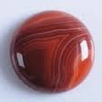
Technique
Burnishing with stone, normally with Aqiq stone or shell.
Tracing or Drawing
Wash Layer by layer (color or tea wash….)
Tapai (rendering to make the strokes balance)
Pardakht (dotted) (rendering for detailing)with Qalm (Traditional Technique) through which we
can fill the grains of wasli.

Slide 15
Border Design
Illumination
Use of Silver and Gold Leaf
Jharr ( Sprinkle form)

Slide 16
Characteristics
A very fine line quality, refinement, detail…
A small painting gives us so much knowledge
It is 2-Dimensional Painting
Two view perspective is used at a time (illustrative)
Rich and Bright colors
Figures are painted according to their Social status
Idealized landscape
Decorative borders ( Hashiyah)
Lines between painting and border (jidwal/jadool)
Arabesque Designs (Scrolls wine floral, Geometric and calligraphic designs)
Script used to be the part of a painting either in border and sometimes in the painting.
Subject matter is mostly historical, poetic, war scenes, Hammam Scenes and court scenes.
Miniature paintings were never done by single artist, but by the team of artists working in the workshop/atelier.
Faces (Portraits) used to be paint in Side view and bodies in semi front and front view.

Slide 17
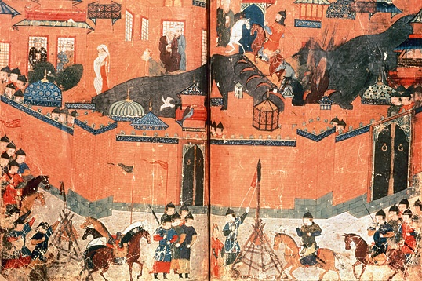
Two view perspective (illustrative)

Slide 18
Bright Colors

Slide 19
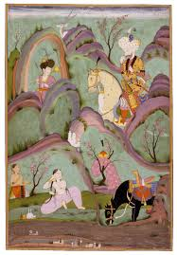
Two View Perspective

Slide 20
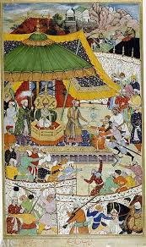

Slide 21
Arabesque Designs Illumination

Slide 22
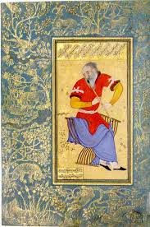
Decorative borders (Hashiyah)

Slide 23
Subject Matter
For recording history
Illustration of Poetry
Court Scenes
Portraiture
Flora and fauna ( Plants and Animals)
Idealized Landscapes
Calligraphy/ Script
Hammam Scenes
War Scenes
Religious scenes

Slide 24
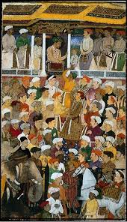
Court Scene in Persian & Mughal Miniatures

Slide 25
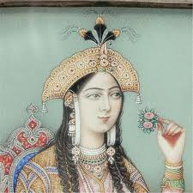
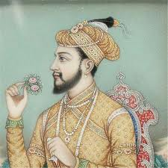
Portraiture: Side view and bodies in semi front

Slide 26
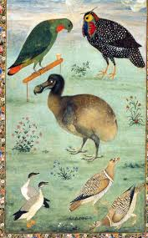
Flora & fauna of Mughal Miniatures with Border design

Slide 27
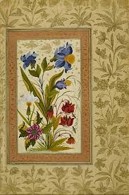

Slide 28
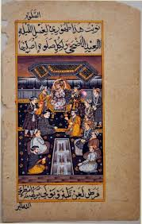
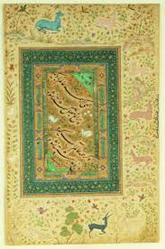
Calligraphy

Slide 29
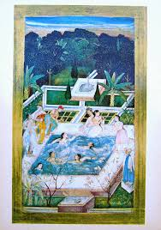
Hammam

Slide 30
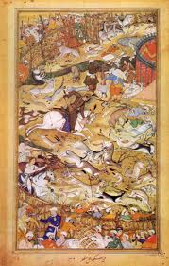
War Scene

Slide 31
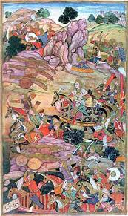
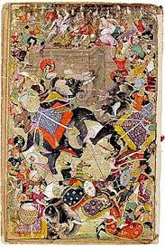
War Scene

Slide 32
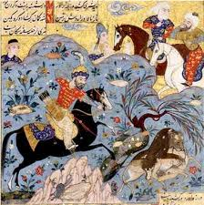
War scene in Persian Miniatures

Slide 33
History by Reign and Regions
Different schools of miniature were established in different eras in Sub continent:
Persian (Timurid, Safavid)
Mughals (Humayun, Akbar, Jahangir, Shah Jahan Periods)
India ( Rajput school consisting of Rajasthani and Paharai School)
Mughal Emperor Hamayun led the foundation of Mughal miniature Painting in sub continent.

Slide 34
Miniature Painting were done by group of people. It was a collective team work done by different experts.
Hamayun brought two Persian artists Mir Sayyed Ali and Khawaja Abdul Samad from Persia to Indian Continent.
They developed a school of Mughal Miniature Painting.

Slide 35
Artists were specially employed to promote the art of book illustration or illustrative manuscript.
Under the patronage of Mughal emperors and with the guidance of two senior artists this art form was flourished in an ‘Imperial Library’.
Preparation of ink, colors, Brush, paper, Gold beating, Book binding, covering etc…

Slide 36
Contemporary Minaiture By Kasur Iqbal

Slide 37
By Kasur Iqbal

Slide 38
Siyah Qalam by Kasur Iqbal

Slide 45
Rajput school, Kangra School, Paharai School

Slide 48
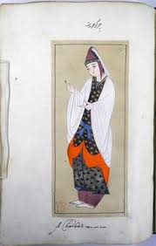

Slide 49
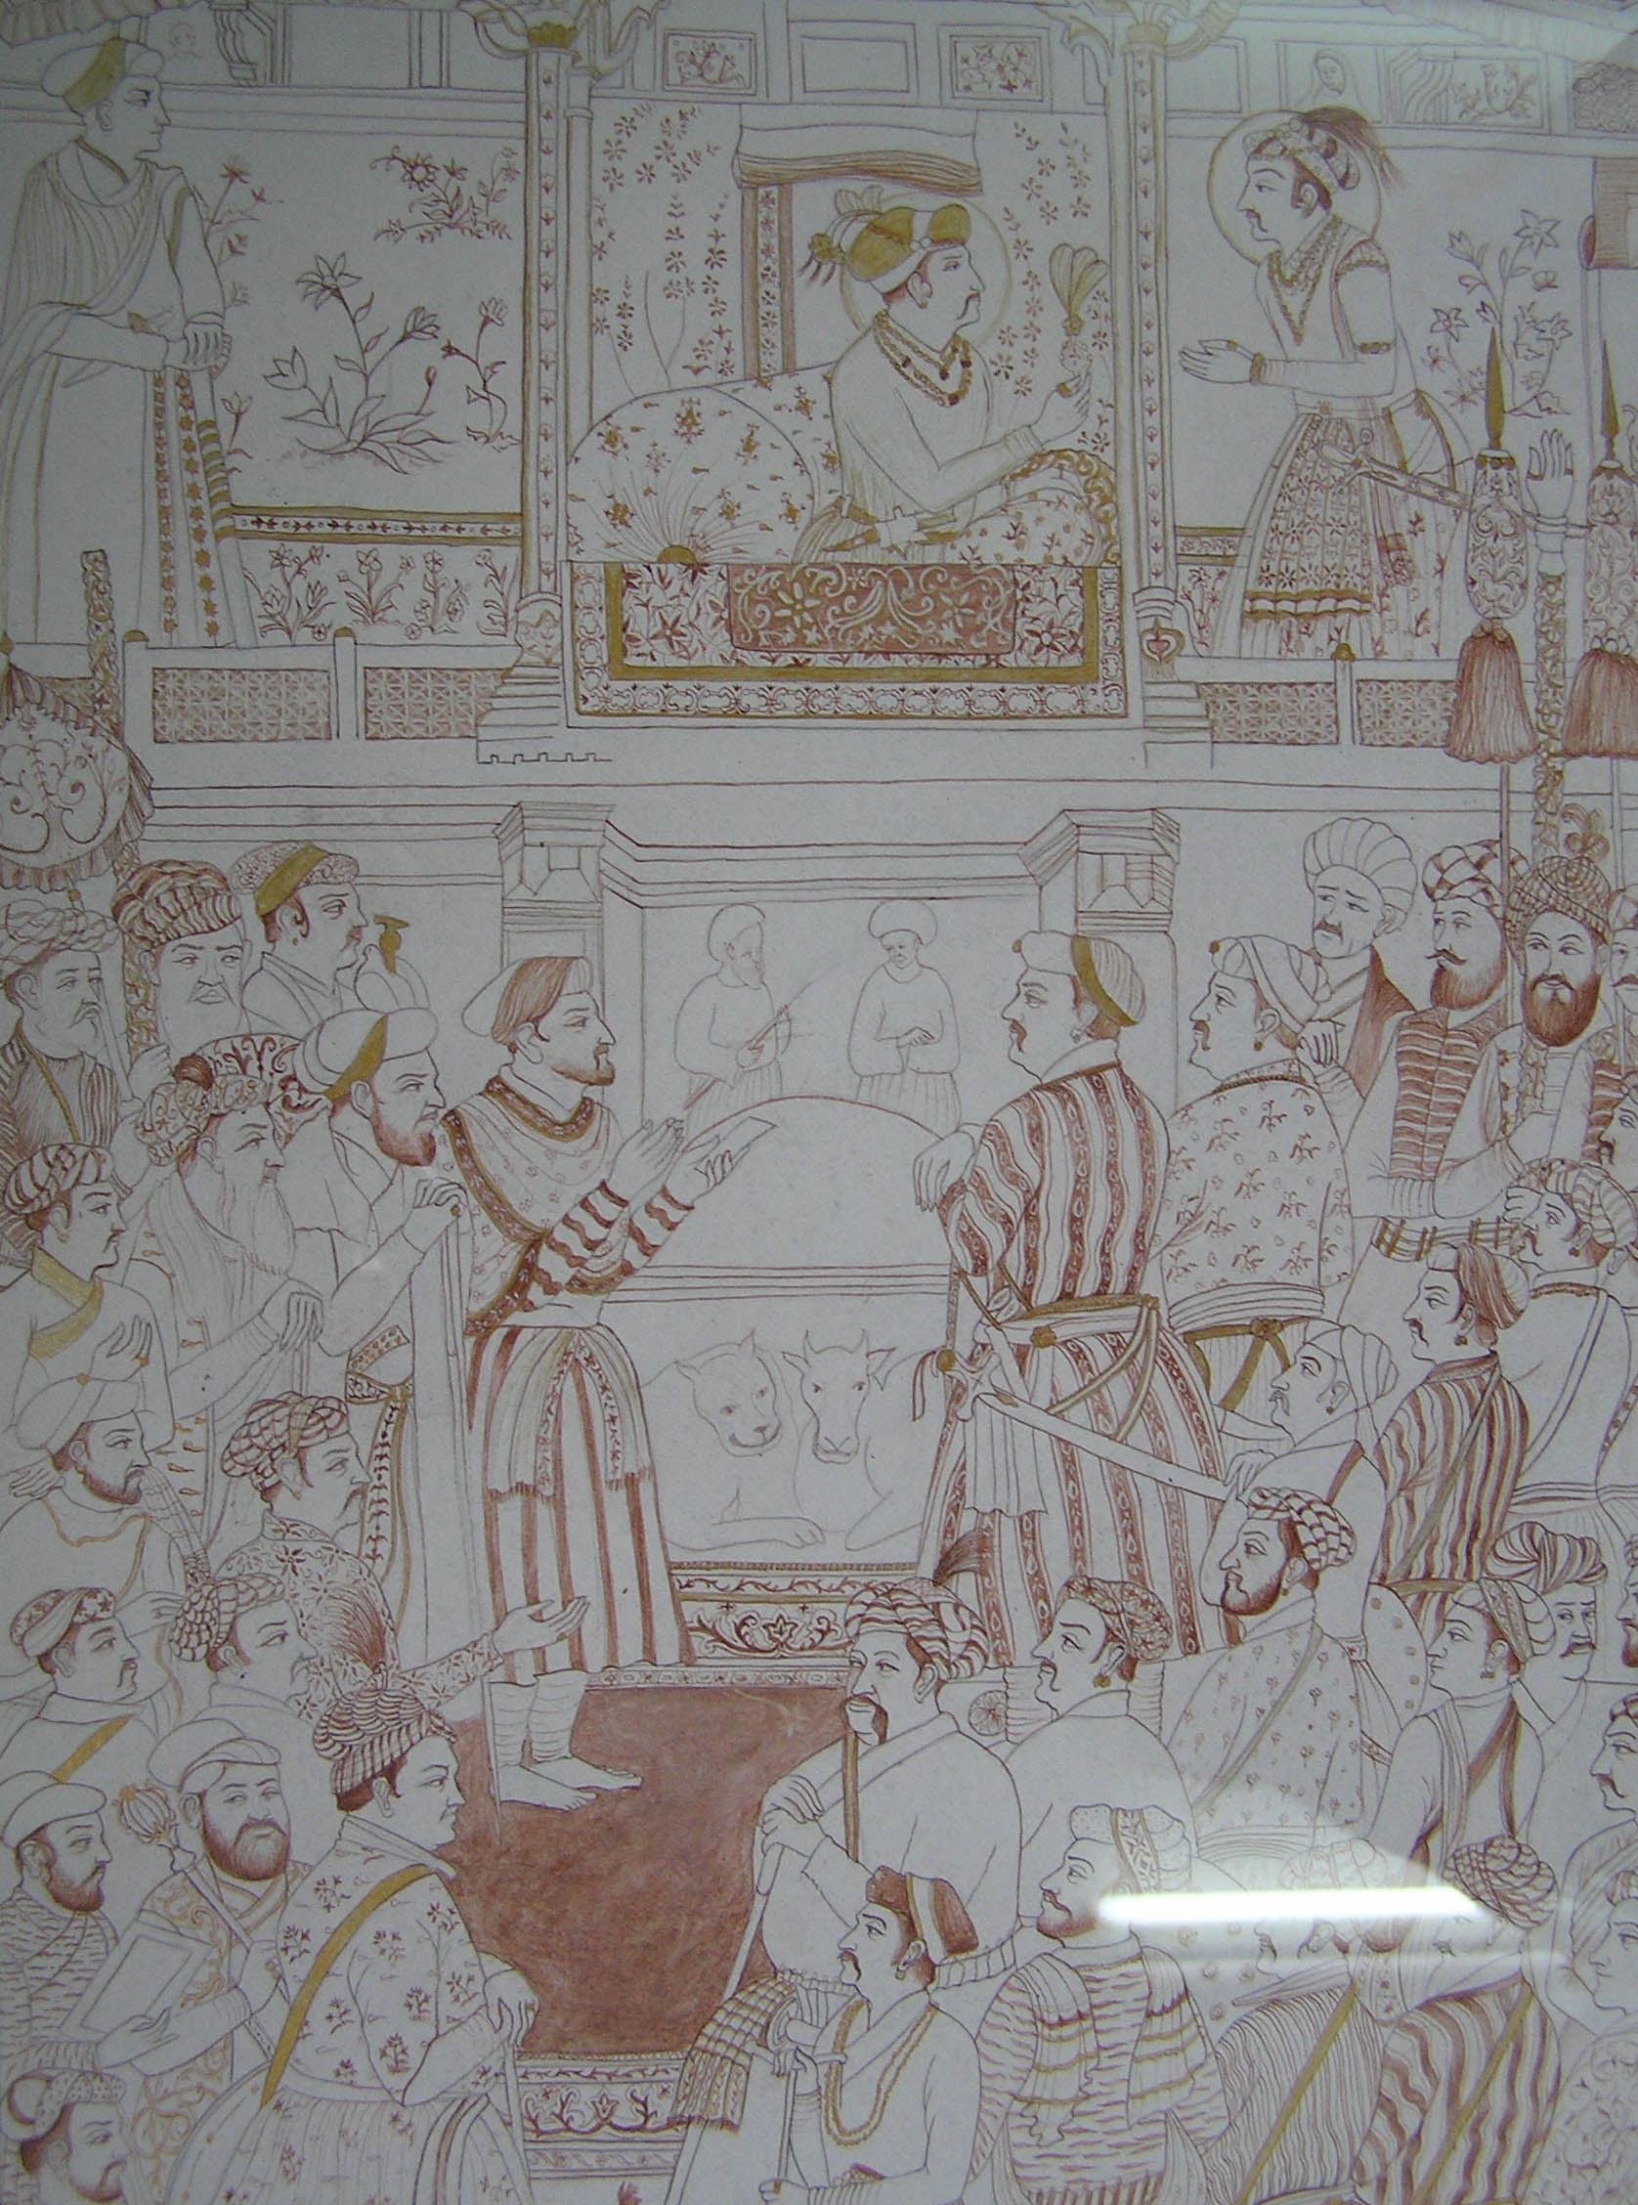

Slide 50
